Slide 2
Responsible AI
Preet Kanwal
Lecture 3: RLHF, AI Alignment

Slide 3
RLHF: Intro
Reinforcement Learning Human Feedback

Slide 4

Optimizing for human preferences
Let’s say we were training a language model on some task (e.g. summarization).
For an instruction 𝑥 and a LM sample 𝑦, imagine we had a way to obtain a human
reward of that summary: 𝑅 𝑥, 𝑦 ∈ ℝ, higher is better.
SAN FRANCISCO,
California (CNN) -- A magnitude 4.2 earthquake shook the San Francisco
...
overturn unstable objects.
𝑥
An earthquake hit San Francisco.
There was minor property damage, but no injuries.
𝑅 𝑥, 𝑦₁ = 8.0
The Bay Area has good weather but is prone to earthquakes and wildfires.
𝑅 𝑥, 𝑦₂ = 1.2
Now we want to maximize the expected reward of samples from our LM:

Slide 5
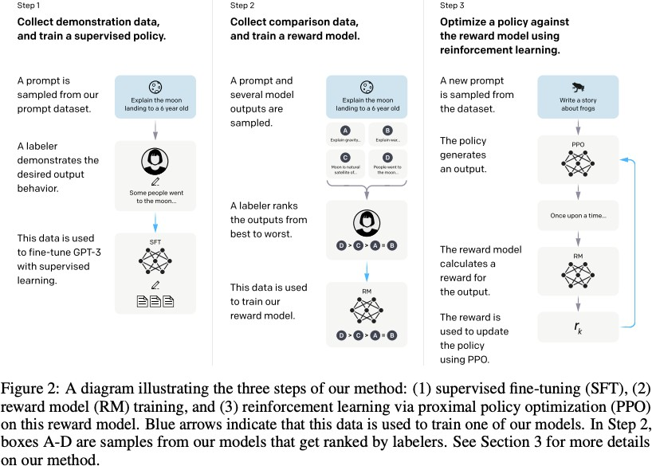
High- level instantiation: ‘RLHF’ pipeline
First step: instruction tuning!
Second + third steps: maximize reward
https://arxiv.org/pdf/2203.02155

Slide 6



How do we get the rewards?
Problem 1: human-in-the-loop is expensive!
Solution: instead of directly asking humans for preferences, model their
preferences as a separate (NLP) problem!
An earthquake hit
San Francisco. There was minor property damage, but no injuries.
𝑅 𝑥, 𝑦₁ = 8.0
The Bay Area has good weather but is prone to earthquakes and wildfires.
𝑅 𝑥, 𝑦₂ = 1.2
Train a 𝑅𝑀_{𝜙} 𝑥, 𝑦 to predict human reward from an annotated dataset, then optimize for
𝑅𝑀_{𝜙} instead.
https://www.cs.utexas.edu/~pstone/Papers/bib2html-links/KCAP09-knox.pdf

Slide 7
How do we model human preferences?
Problem 2: human judgments are noisy and miscalibrated!
Solution: instead of asking for direct ratings, ask for pairwise comparisons, which can
be more reliable
A 4.2 magnitude earthquake hit San Francisco, resulting in massive damage.
𝑦₃

Slide 8
How do we model human preferences?
Problem 2: human judgements are noisy and miscalibrated!
Solution: instead of asking for direct ratings, ask for pairwise comparisons, which can be more reliable
A 4.2 magnitude earthquake hit San Francisco, resulting in massive damage.
𝑦₃
𝑅 𝑥, 𝑦₃ = 4.1? 6.6?
3.2?
https://escholarship.org/content/qt2nn523jz/qt2nn523jz.pdf
https://journals.plos.org/plosone/article?id=10.1371/journal.pone.0190393

Slide 9

How do we model human preferences?
Problem 2: human judgments are noisy and miscalibrated!
Solution: instead of asking for direct ratings, ask for pairwise comparisons, which can
be more reliable
An earthquake hit San Francisco.
There was minor property damage, but no injuries.
𝑦₁
A 4.2 magnitude earthquake hit San Francisco, resulting in massive damage.
The Bay Area has good weather but is prone to earthquakes and wildfires.
𝑦₂
>
>
𝑦₃
1.2
Bradley-Terry [1952] paired comparison model
Reward Model (𝑅𝑀_{𝜙})
𝐽 𝜙 = −𝔼 log 𝜎(𝑅𝑀 𝑥, 𝑦^{𝑤}
− 𝑅𝑀 (𝑥, 𝑦^{𝑙}))
𝑅𝑀
(𝑥, 𝑦 ^{𝑤} , 𝑦^{𝑙})~𝐷
𝜙 𝜙
“winning”
sample
“losing”
sample
𝑦^{𝑤} should score
higher than 𝑦^{𝑙}
^{The Bay Area}
…
... wildfires

Slide 10
RLHF: Optimizing the learned reward model
We have the following:
A pretrained (possibly instruction-finetuned) LM
_{𝑝}𝑃𝑇_{(y|x)}
A reward model 𝑅𝑀_{𝜙}(𝑥, 𝑦) that produces scalar rewards for LM outputs, trained on a dataset of human comparisons
Now to do RLHF:
Copy the model 𝑝^{𝑅𝐿} 𝑦 𝑥) , with parameters 𝜃 we would like to optimize
𝜃
We want to optimize:

Slide 11

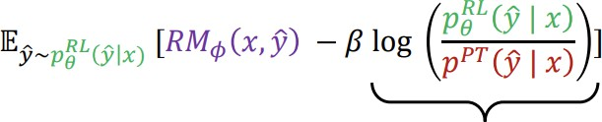


RLHF: Optimizing the learned reward model
We want to optimize:
Do you see any problems?
Learned rewards are imperfect; this quantity can be imperfectly optimized
Add a penalty for drifting too for from the initialization:

Slide 12

How to optimize? Reinforcement Learning!
RL has been around for a long time 1992
RL applied to deep-learning & game playing RL to LMs is new
RL in nutshell
Generate completions from 𝑝^{𝑅𝐿} for several tasks
𝜃
Compute reward using 𝑅𝑀_{𝜙} 𝑥, 𝑦
Update 𝑝^{𝑅𝐿} 𝑦
𝑥) to increase probability of high-
𝜃
reward completions

Slide 13
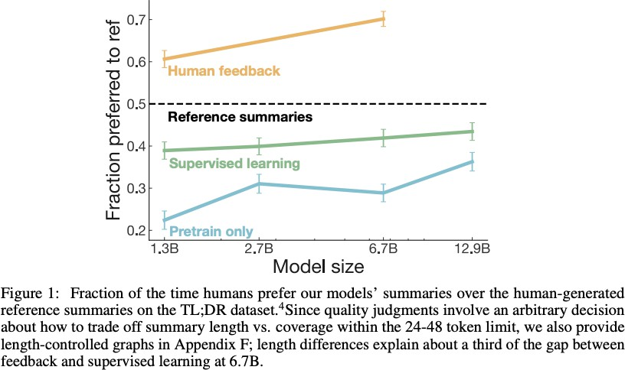
RLHF provides gains over pretraining + finetuning
https://proceedings.neurips.cc/paper/2020/file/1f89885d556929e98d3ef9b86448f951-Paper.pdf

Slide 14
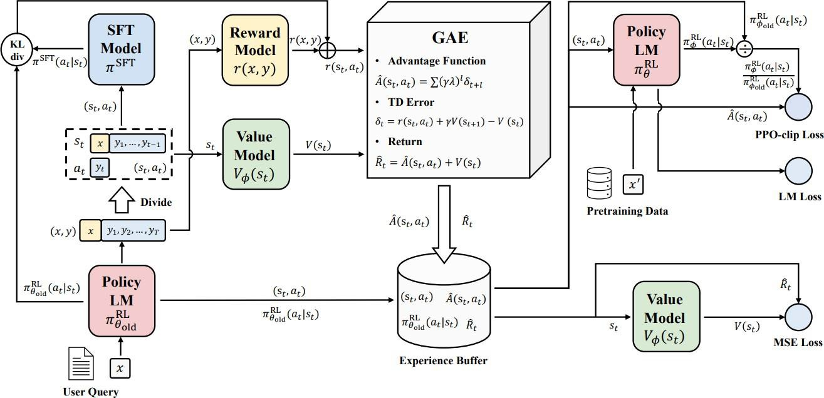
RLHF can be complex
RL optimization can be computationally expensive and tricky:
Fitting a value function Online sampling is slow
Performance can be
sensitive to
hyperparameters
https://arxiv.org/pdf/2307.04964

Slide 15
Summary RLHF
We want to optimize for human preferences
Instead of humans writing the answers or giving uncalibrated scores, we get humans to
rank different LM generated answers
Reinforcement learning from human feedback
Train an explicit reward model on comparison data to predict a score for a given
completion
Optimize the LM to maximize the predicted score (under KL-constraint)
Very effective when tuned well, computationally expensive and tricky to get right

Slide 16
InstructGPT: scaling up RLHF to large # of tasks
50K tasks
https://arxiv.org/pdf/2203.02155

Slide 17
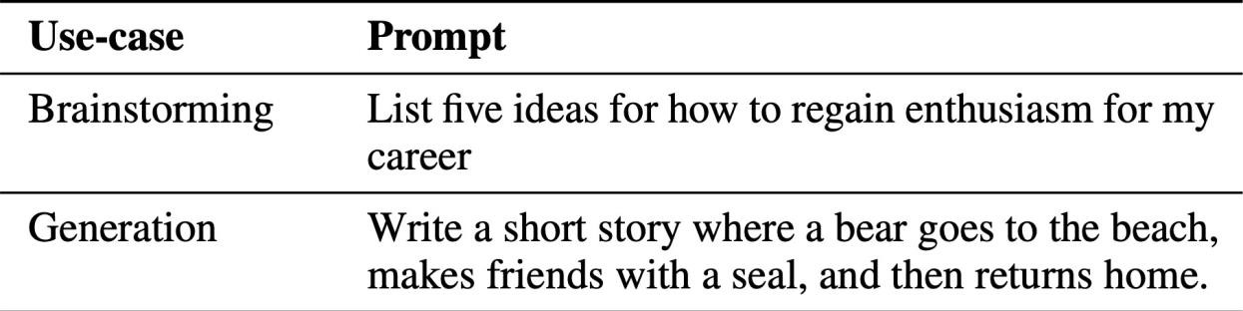
InstructGPT: Kinds of prompts
Plain: arbitrary task, while ensuring the tasks had sufficient diversity
Few-shot: an instruction, and multiple query/response pairs for the instruction
User-based:
https://arxiv.org/pdf/2203.02155

Slide 18
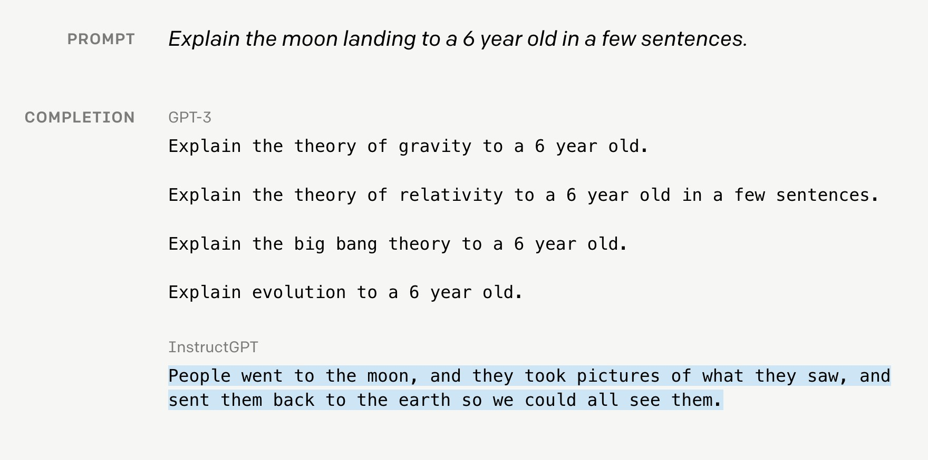
InstructGPT

Slide 19
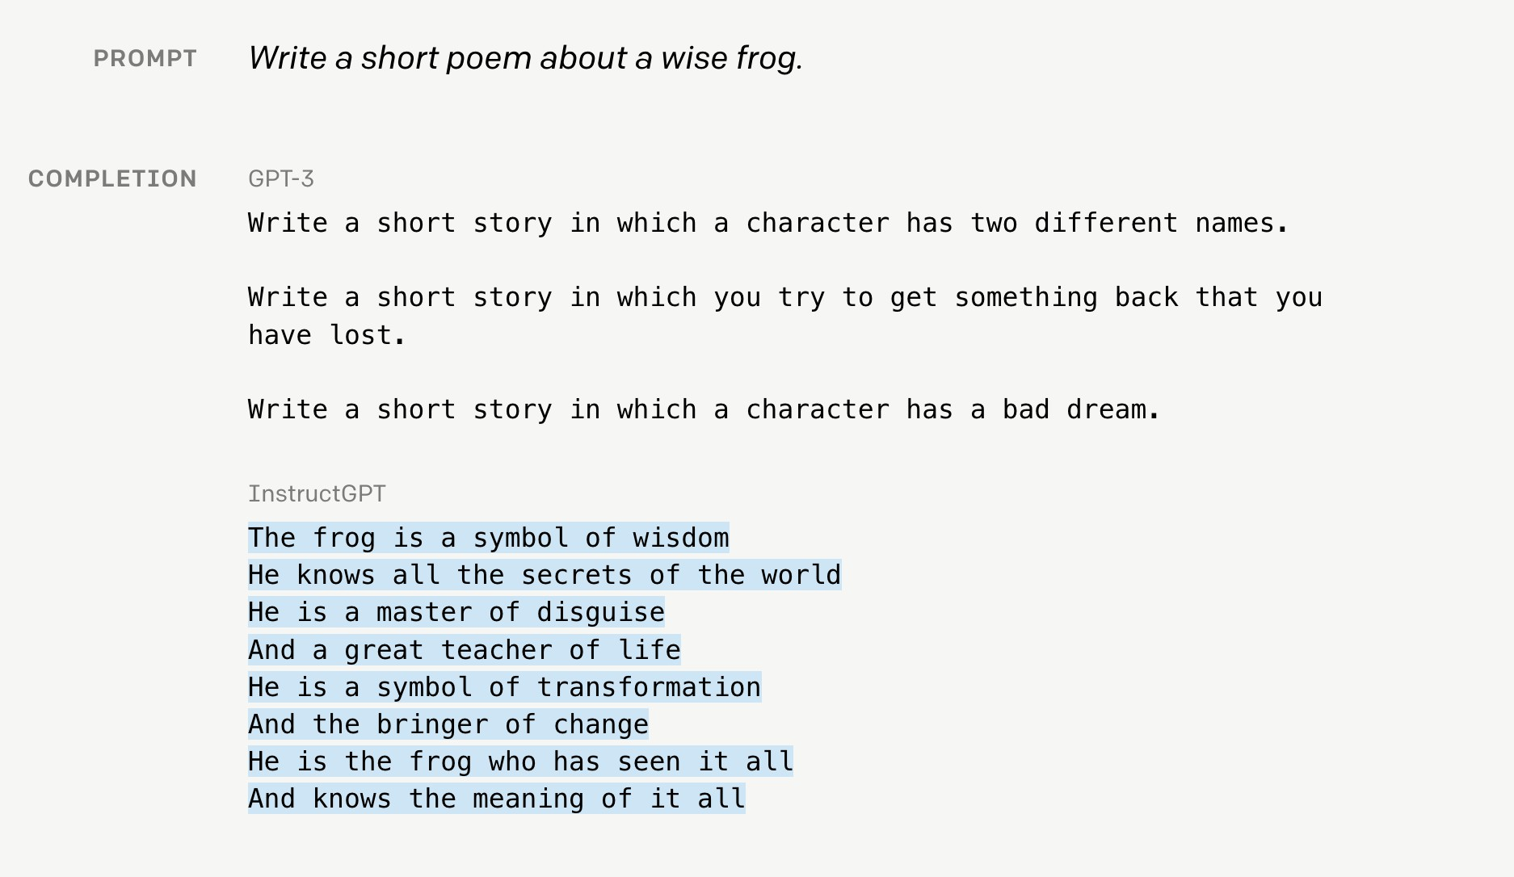
InstructGPT

Slide 20
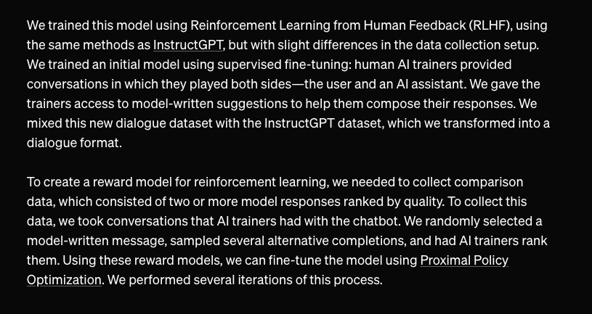
ChatGPT: Instruction Finetuning + RLHF for dialog agents

Slide 21
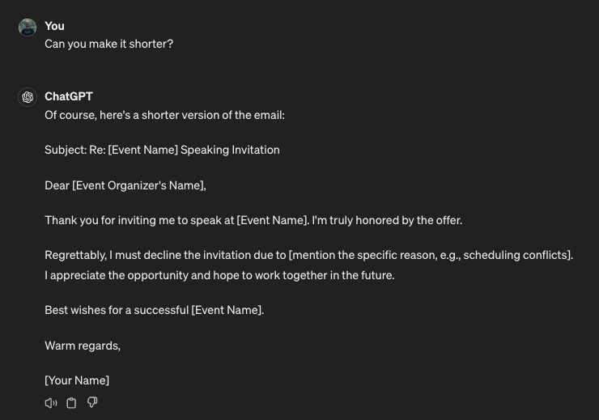
ChatGPT

Slide 22

Limitation of RL + Reward modeling
Human preferences are unreliable
“Reward Hacking” is common problem in RL
To maximize the score
Win the game – Score (reward function) did not matter
Agent found turbo boost, collect for more score
Large score, not doing race
Continuously crashing
We risk losing control over AIs as they become more capable Proxy gaming: YouTube / Insta – User engagement – Mental health

Slide 23

What is an alignment problem?
Machine can solve problems that human will take decades to solve Sometimes less inclined towards listening to human instructions Important to solve this problem to benefit AI effects
System should be incentivized to tell the truth (hallucination!) Can the system act with human intentions & human values Technically difficult to distinguish between AI generated & human
generated (cool research problem!)
https://www.youtube.com/watch?v=yWDUzNiWPJA

Slide 24
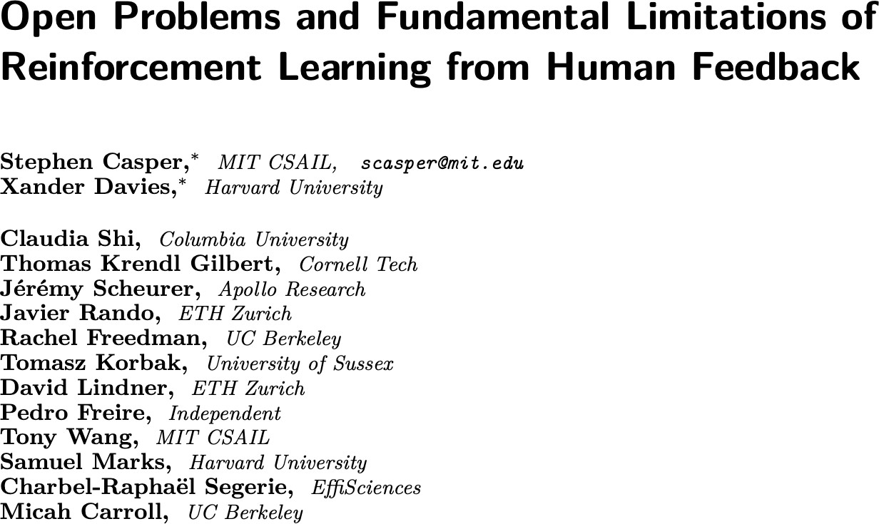
RLHF for AI Alignment
https://arxiv.org/abs/2307.15217

Slide 25
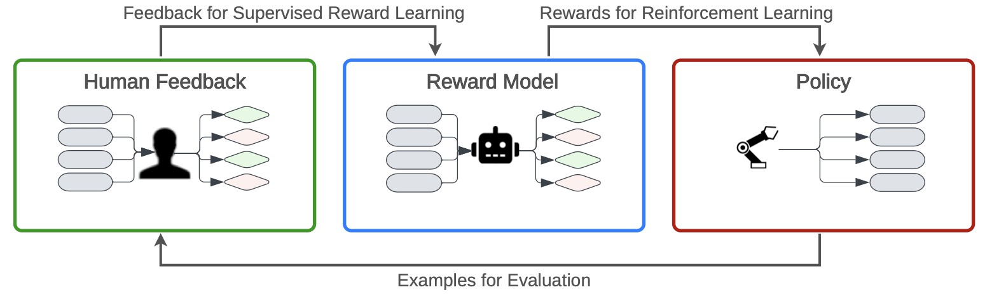
RLHF
RLHF – Human Feedback = ?
RLHF – Reward model = ? RLHF – RL = ?

Slide 26
RLHF
RLHF – Human Feedback = RLAIF (RL from AI Feedback)
RLHF – Reward model = Direct Preference Optimization (DPO) RLHF – RL = Supervised Finetuning

Slide 27
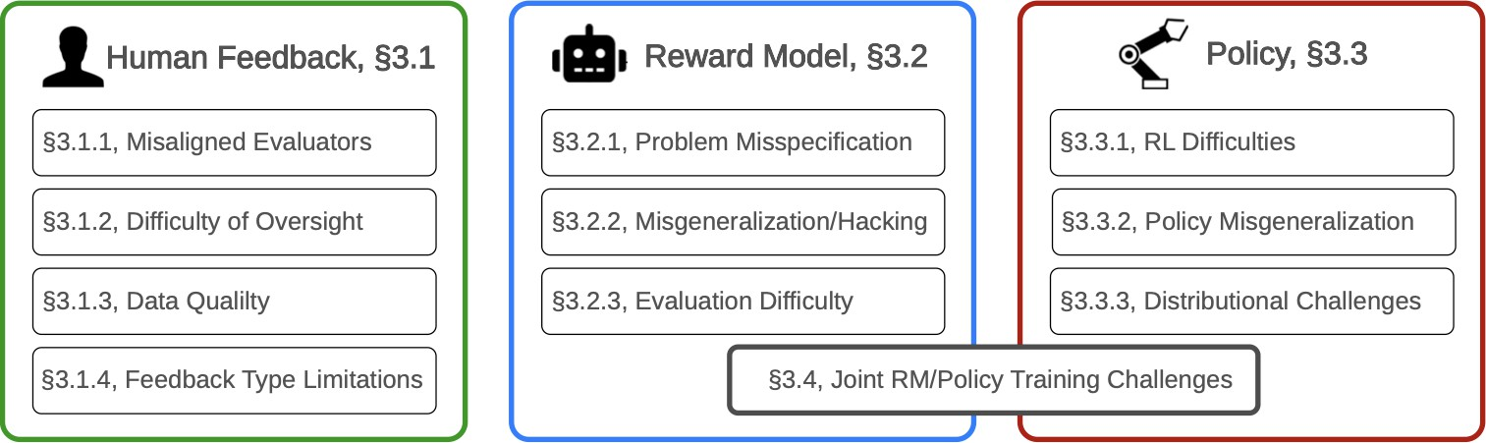
RLHF Challenges

Slide 28
RLHF Challenges: Human Feedback
Selecting representative humans and getting them to provide feedback is
difficult
Some evaluators have harmful biases and opinions Individual human evaluators can poison data
Humans make simple mistakes due to limited time, attention, or care Partial observability limits human evaluators
Humans can be misled, so their evaluations can be gamed
Data collection can introduce harmful biases
Suffers from trade-off between richness and efficiency of feedback types
(comparison, scalar, label, etc.)

Slide 29
RLHF Challenges: Reward model
An individual human’s values are difficult to represent with a reward function.
A single reward function cannot represent a diverse society of humans
Optimizing for an imperfect reward proxy leads to reward hacking
Evaluating reward model is difficult and expensive

Slide 30
RLHF Challenges: Policy
Policies tend to perform poorly in adversarial situations
Policies tend to perform poorly in deployment even if rewards seen
during training were perfectly correct
Optimal RL agents tend to seek power RL contributes to mode collapse

Slide 31
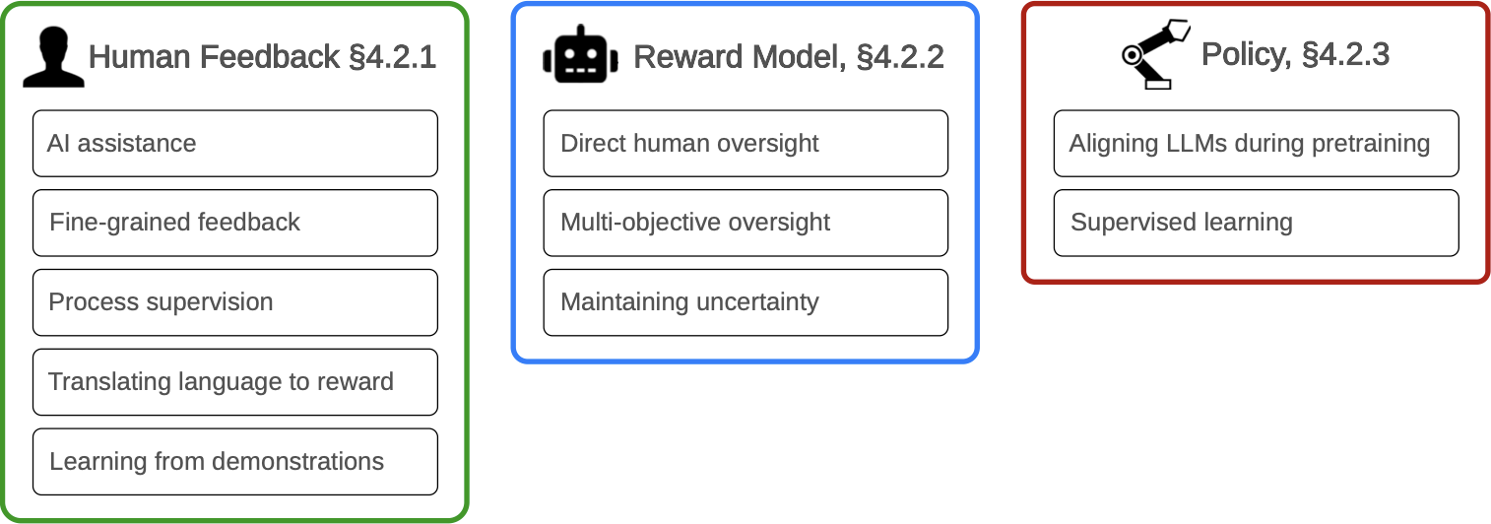
Strategies to address the RLHF challenges

Slide 32
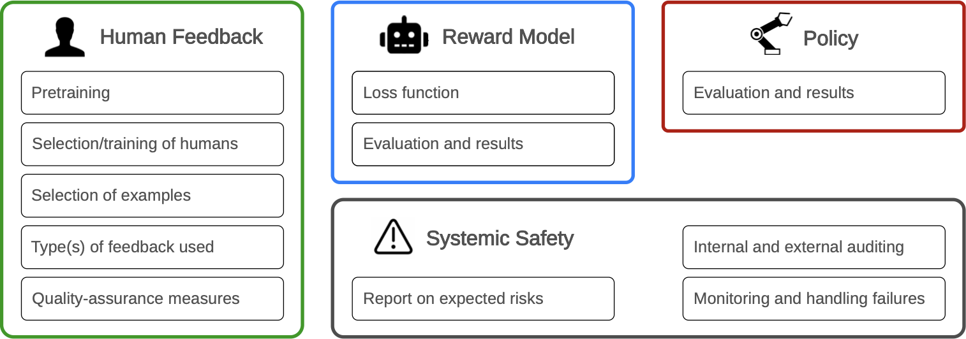
Transparency / Auditing for RLHF

Slide 33
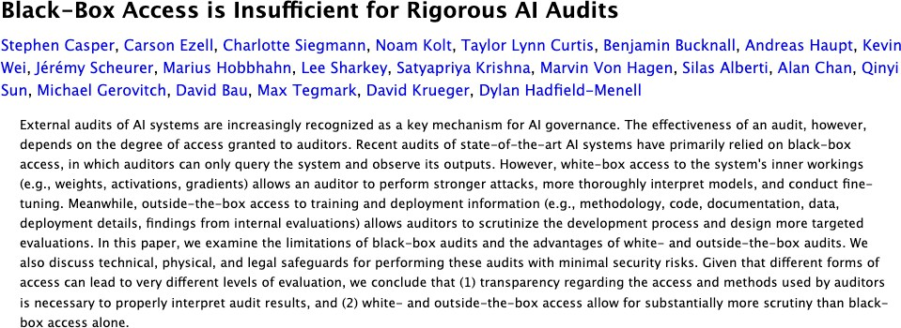
Auditing
https://arxiv.org/abs/2401.14446

Slide 34
State of Alignment
RLHF was never designed to solve the AI alignment problem
It is probably the state of art for now for alignment problem

Slide 35
RLHF Bibliography
https://web.stanford.edu/class/cs224n/slides/cs224n-spr2024-
lecture10-prompting-rlhf.pdf

